Slide 1
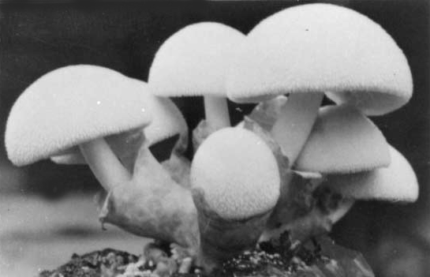
Keys to Development of Form in Fungi
David Moore
School of Biological Sciences, The University of Manchester

Slide 2
The keys to form and structure in fungi
Morphogenesis is not simply a matter of playing out a predefined genetic programme. Expression of developmentally-important genes is:
epigenetic
place-dependent
time-dependent

Slide 3
The keys to form and structure in mycologists
The Child is father
of the Man
William Wordsworth: Intimations of Immortality (1807)

Slide 4
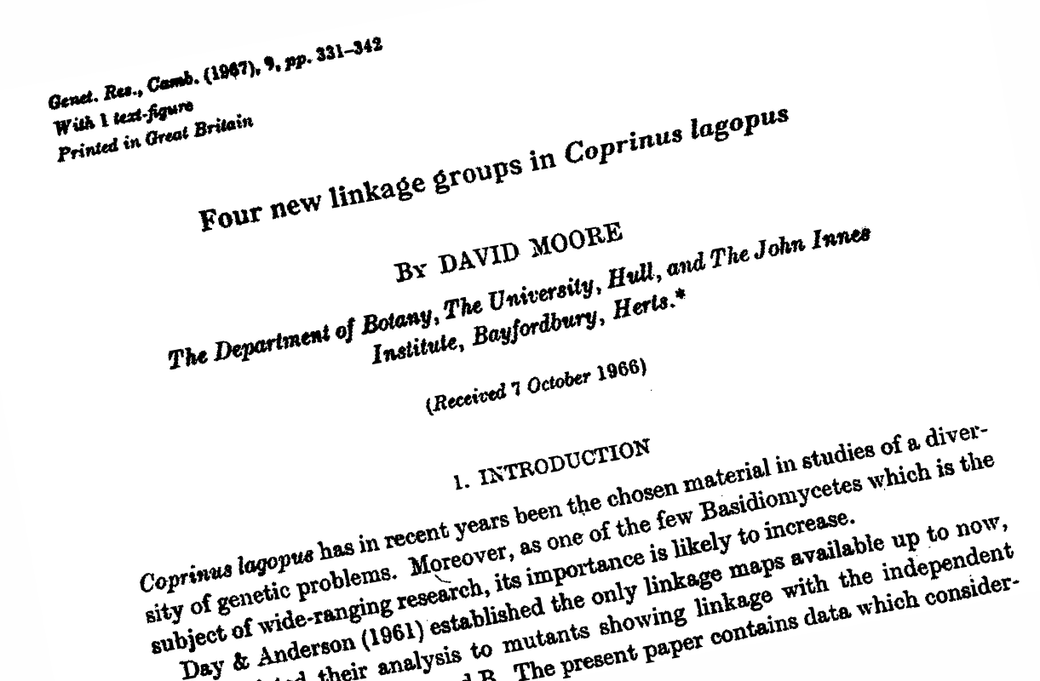

Slide 5
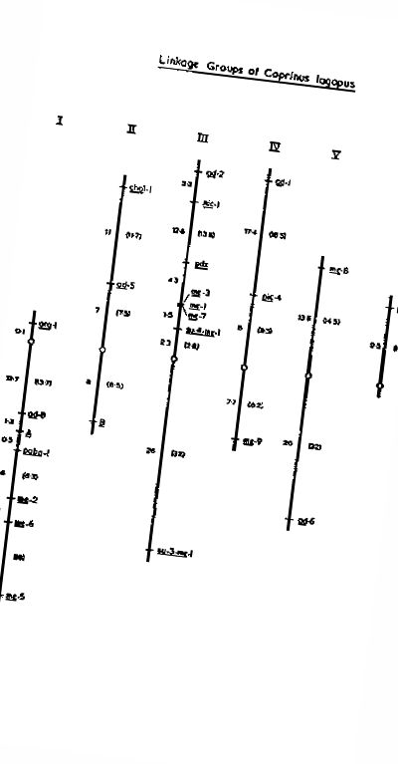

Slide 6
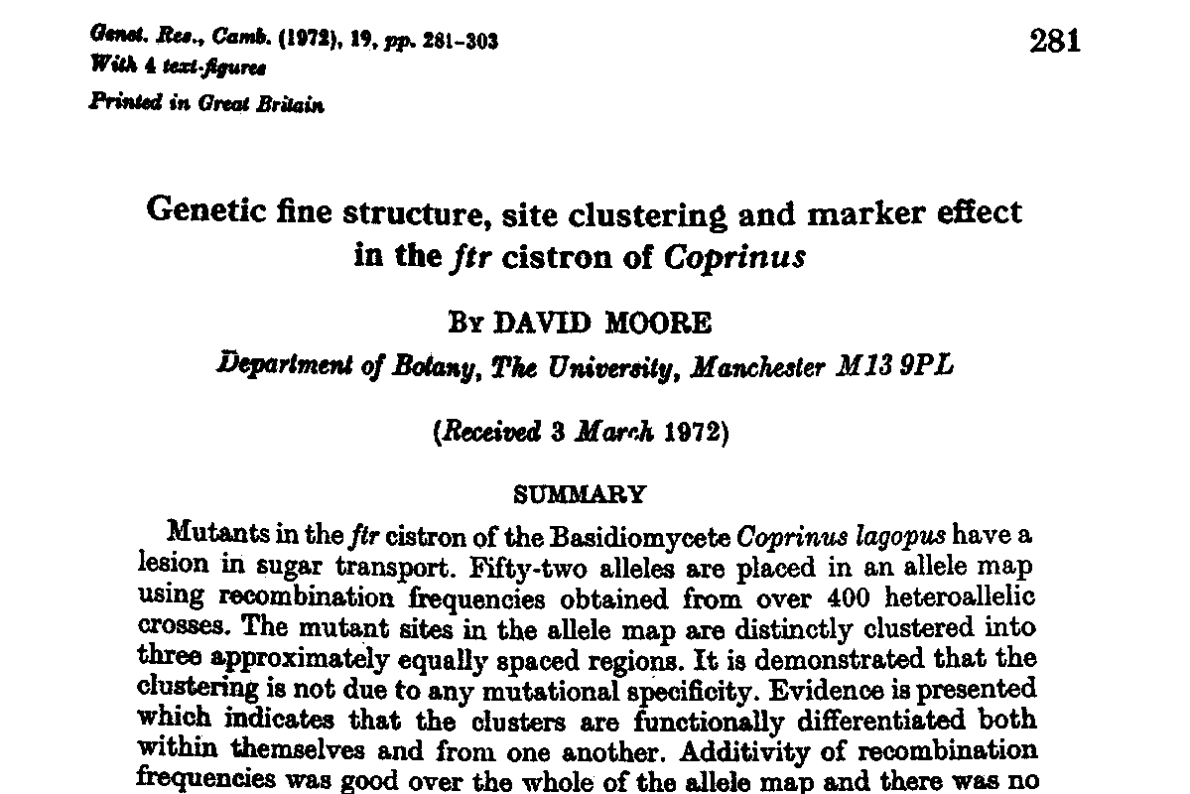

Slide 7
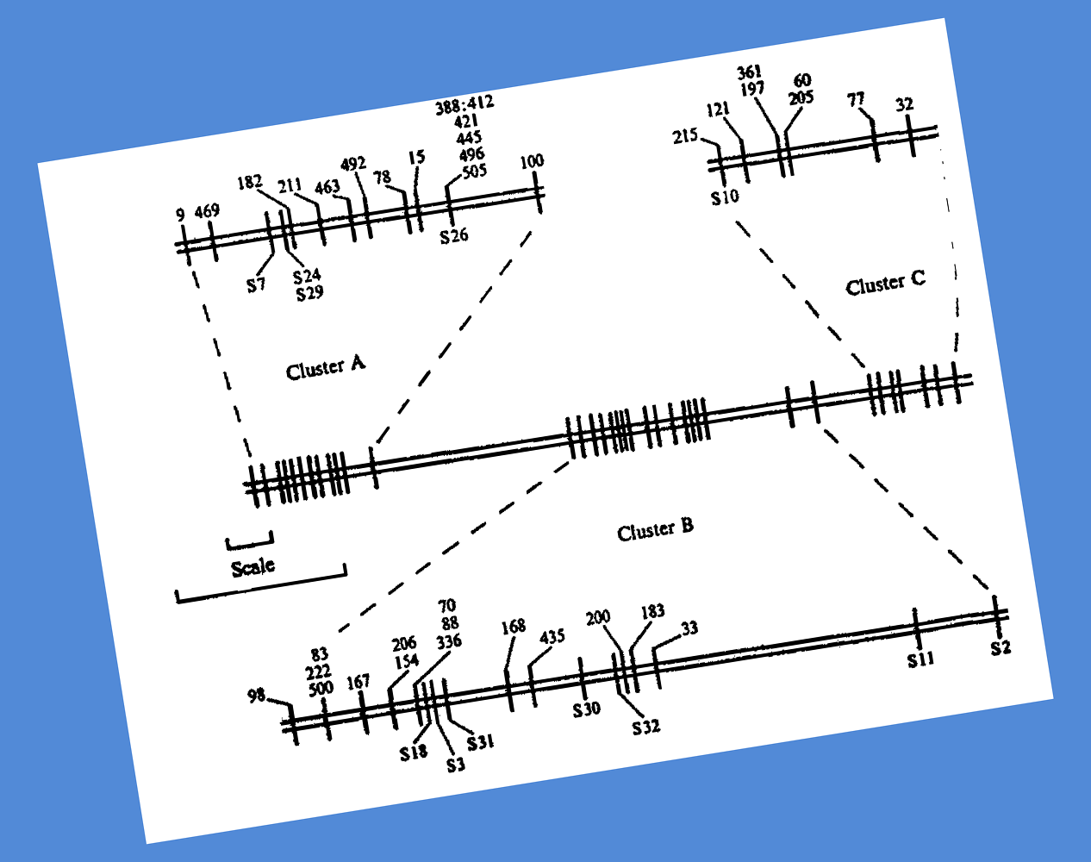

Slide 8
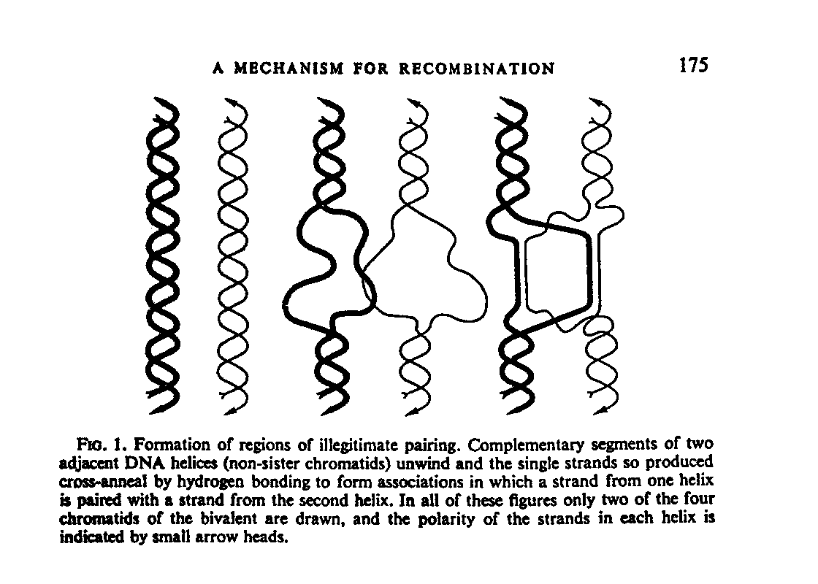

Slide 9
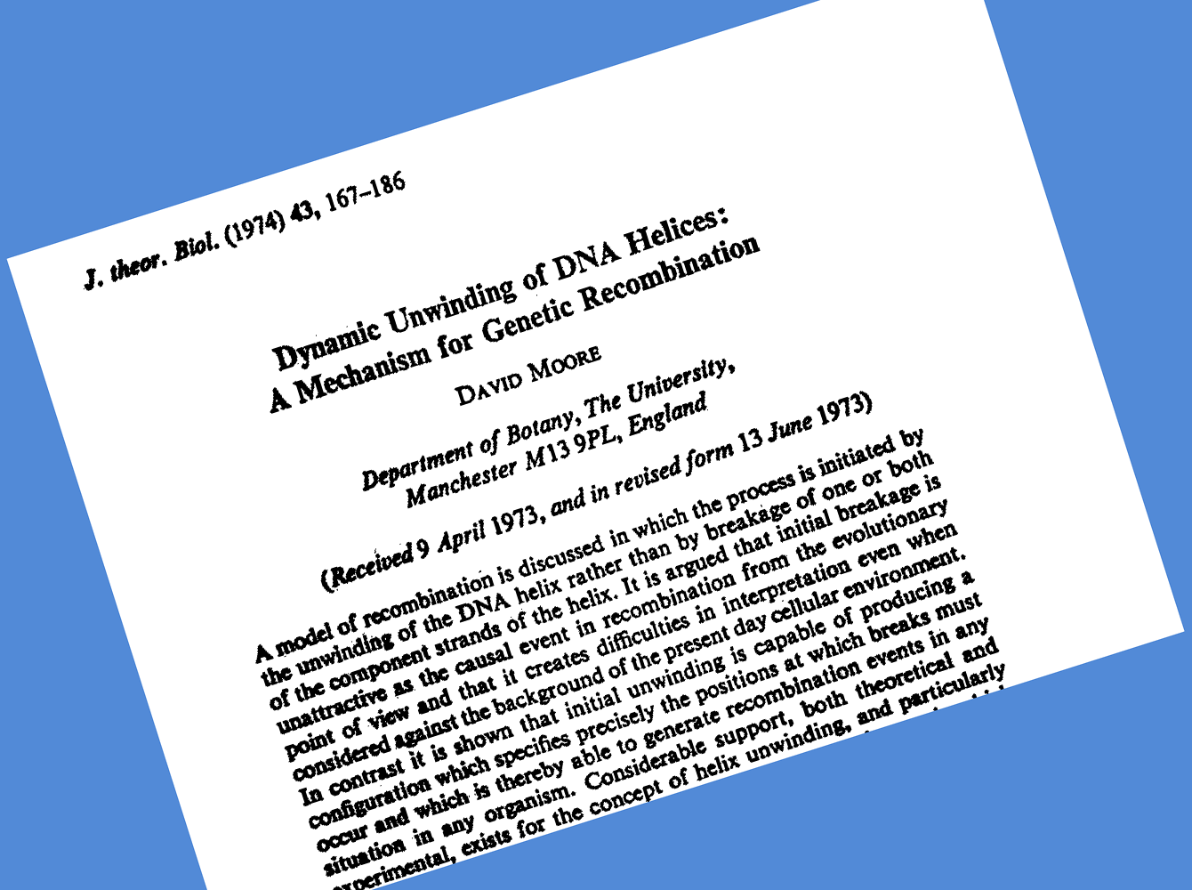

Slide 10
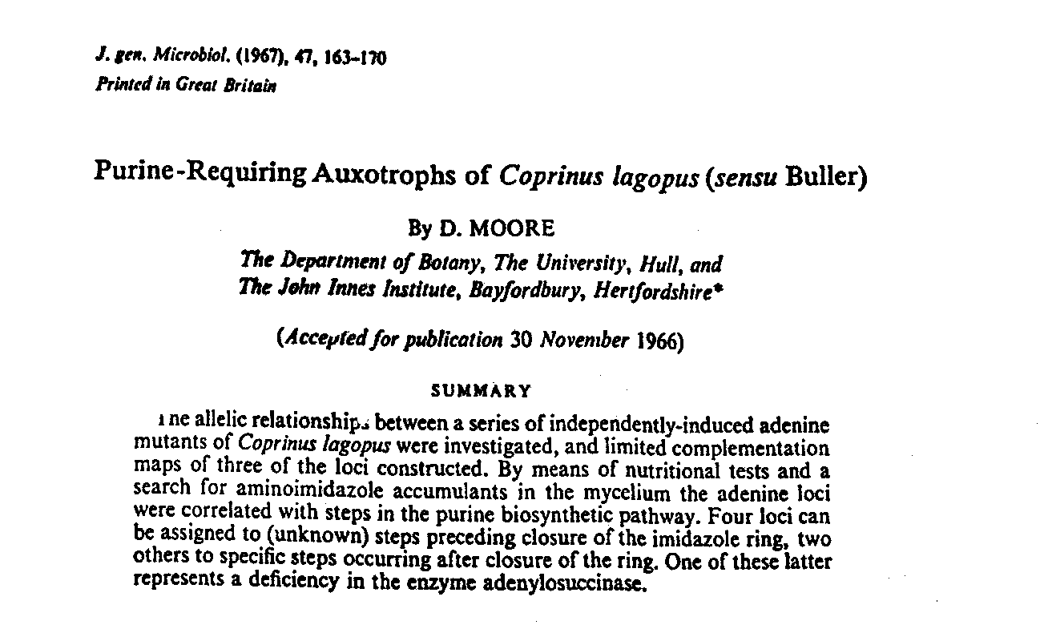

Slide 11
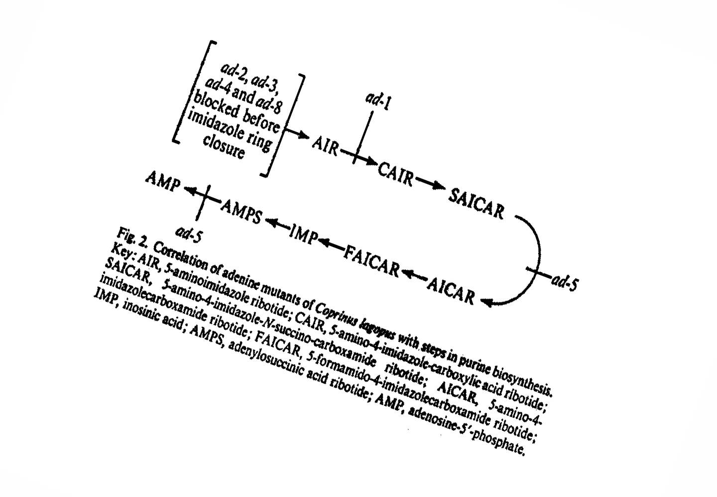

Slide 12
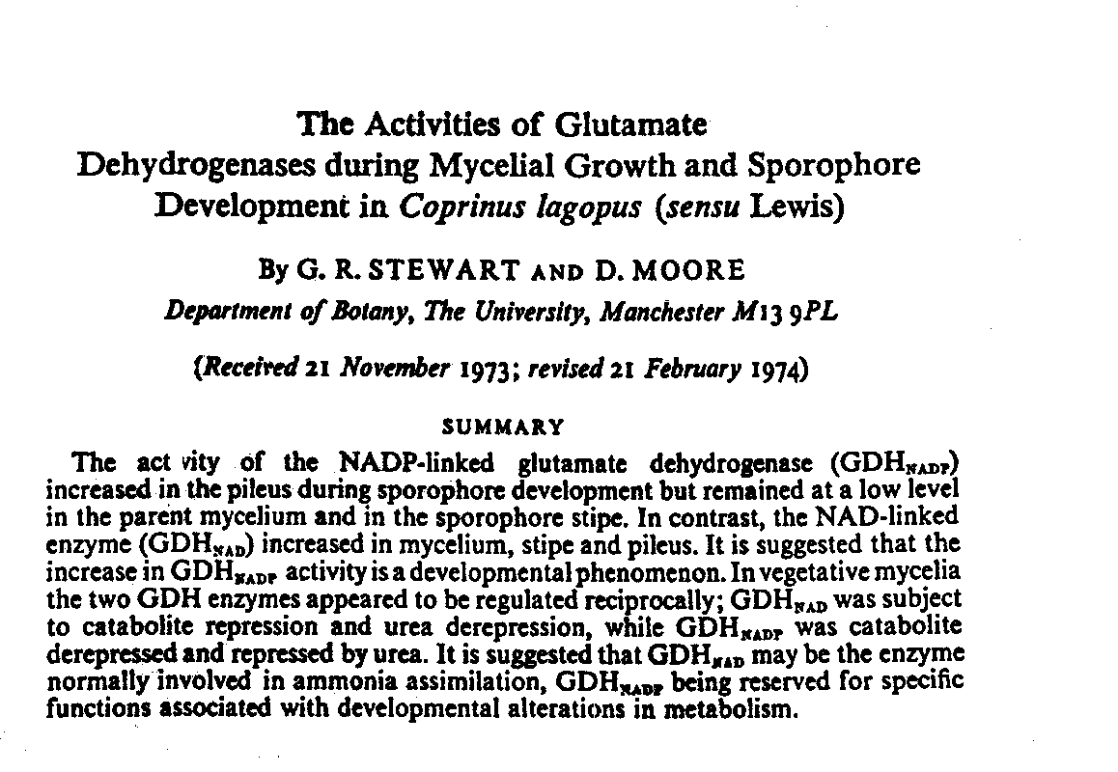
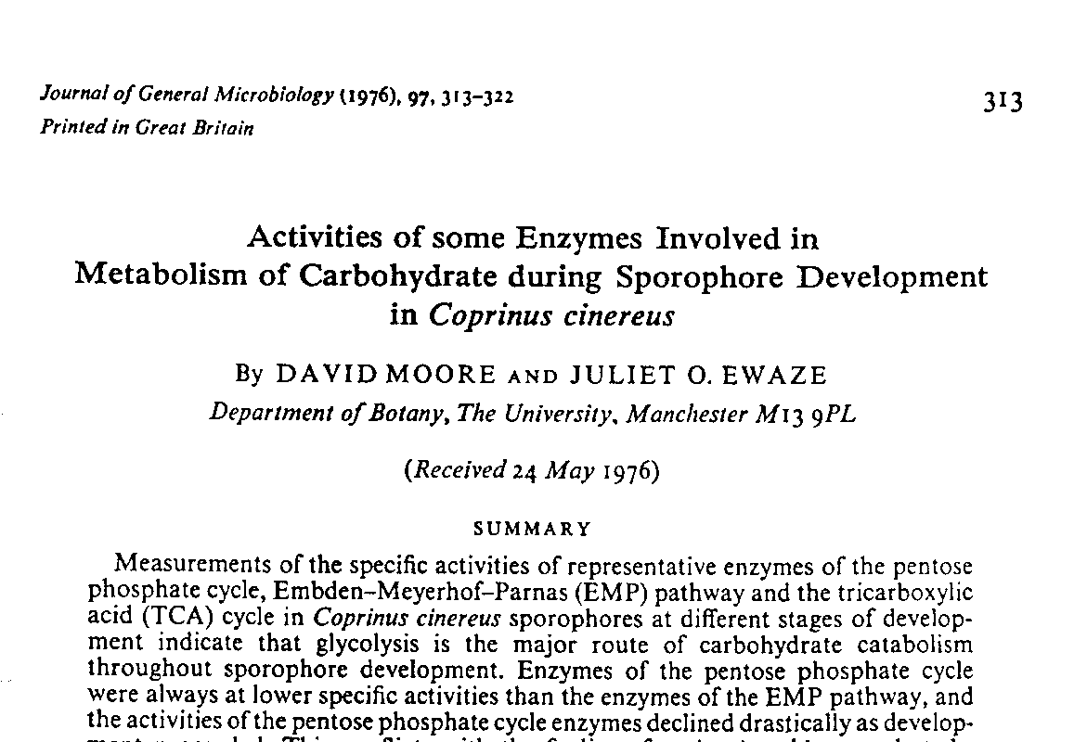

Slide 14
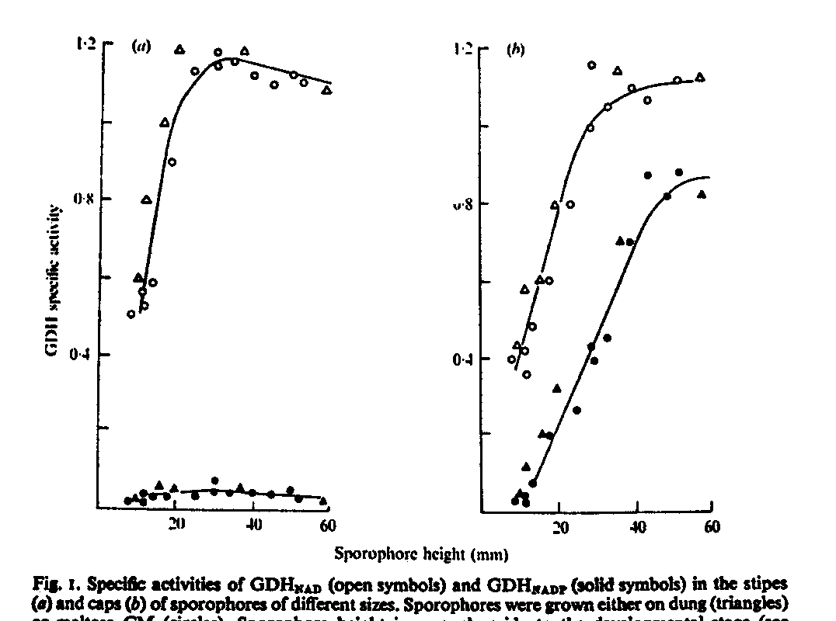
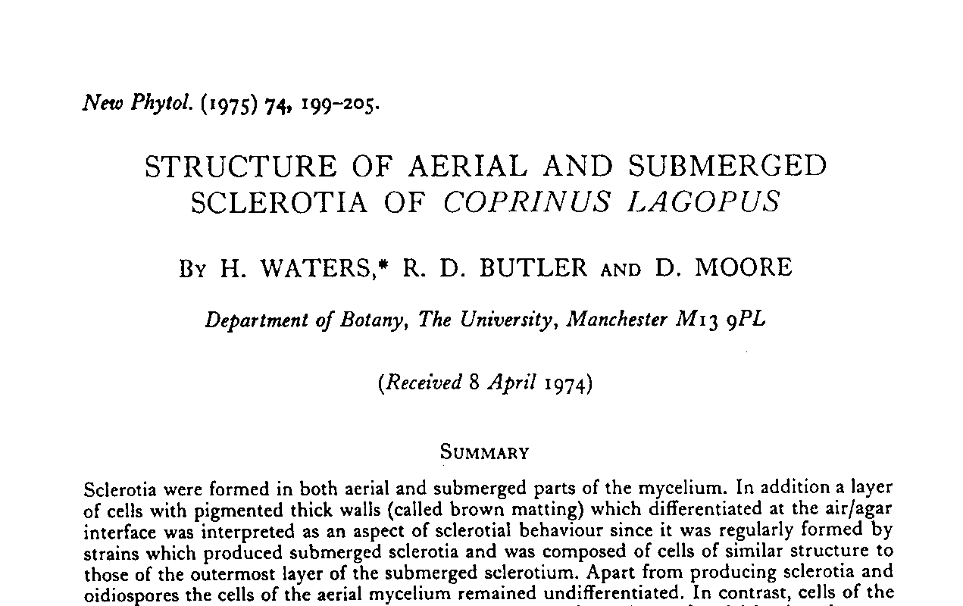

Slide 16
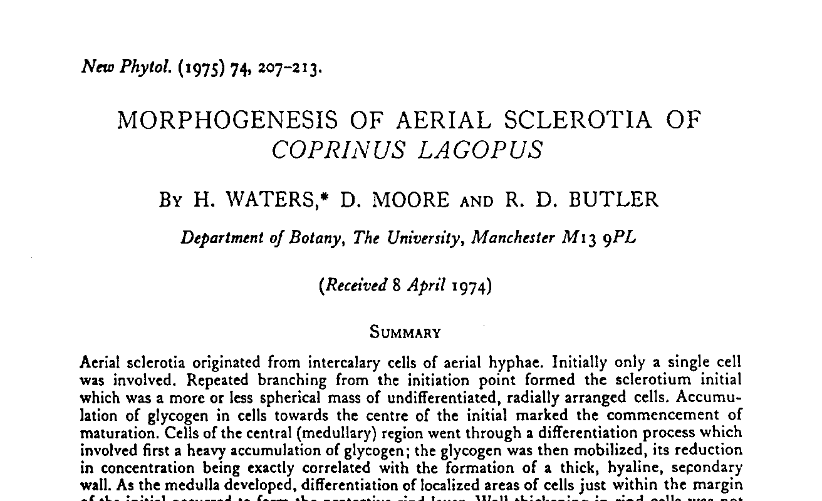
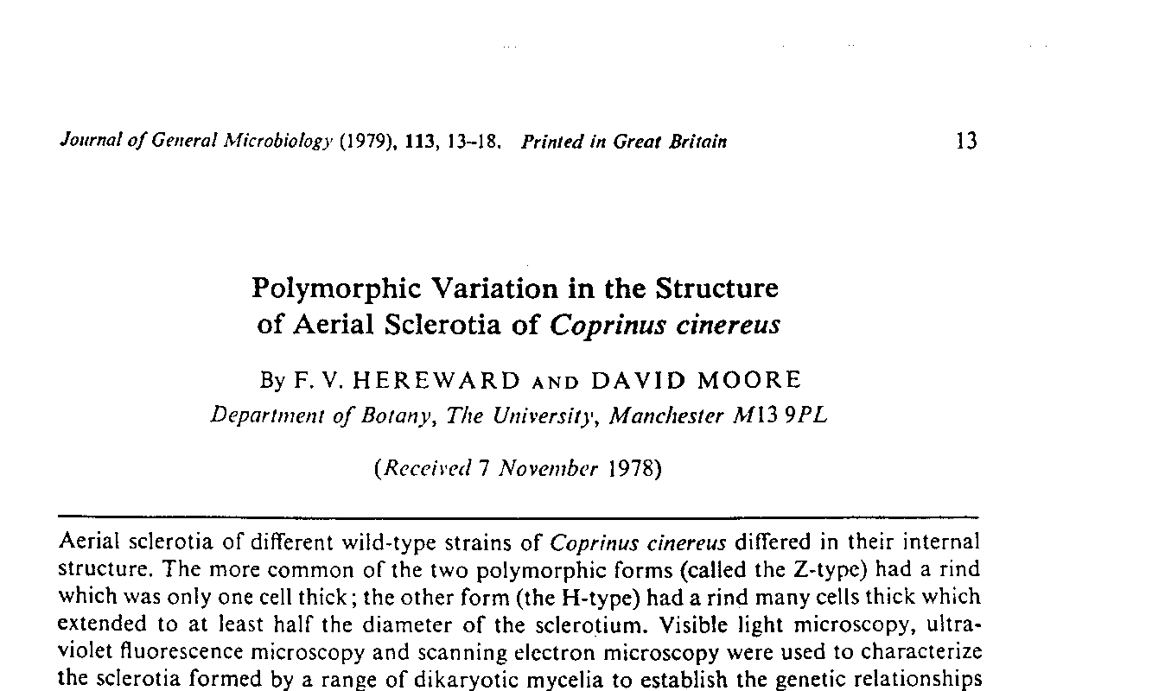

Slide 18
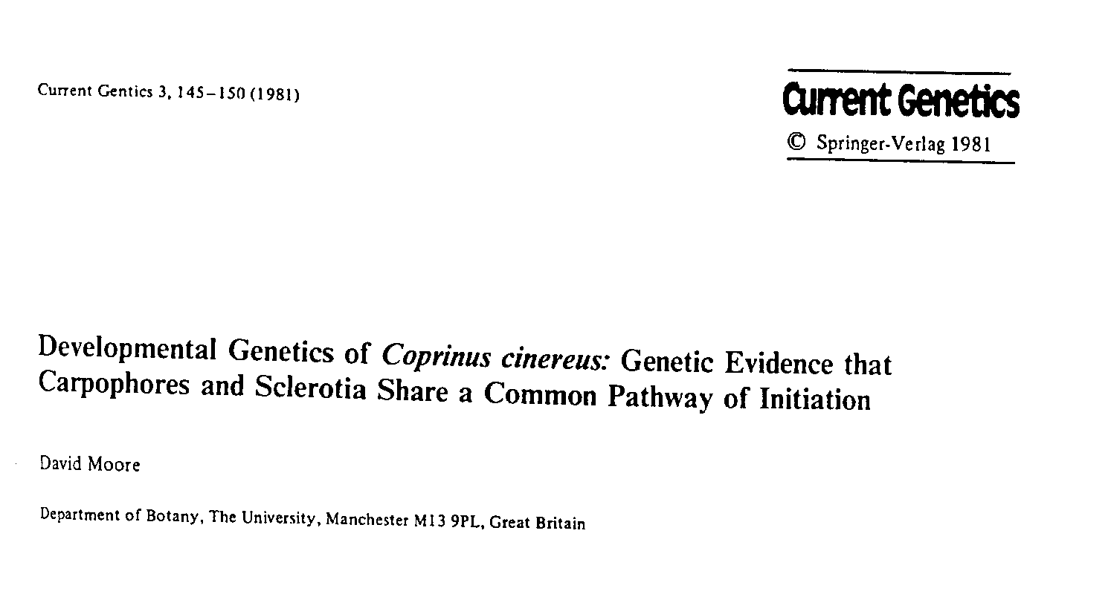
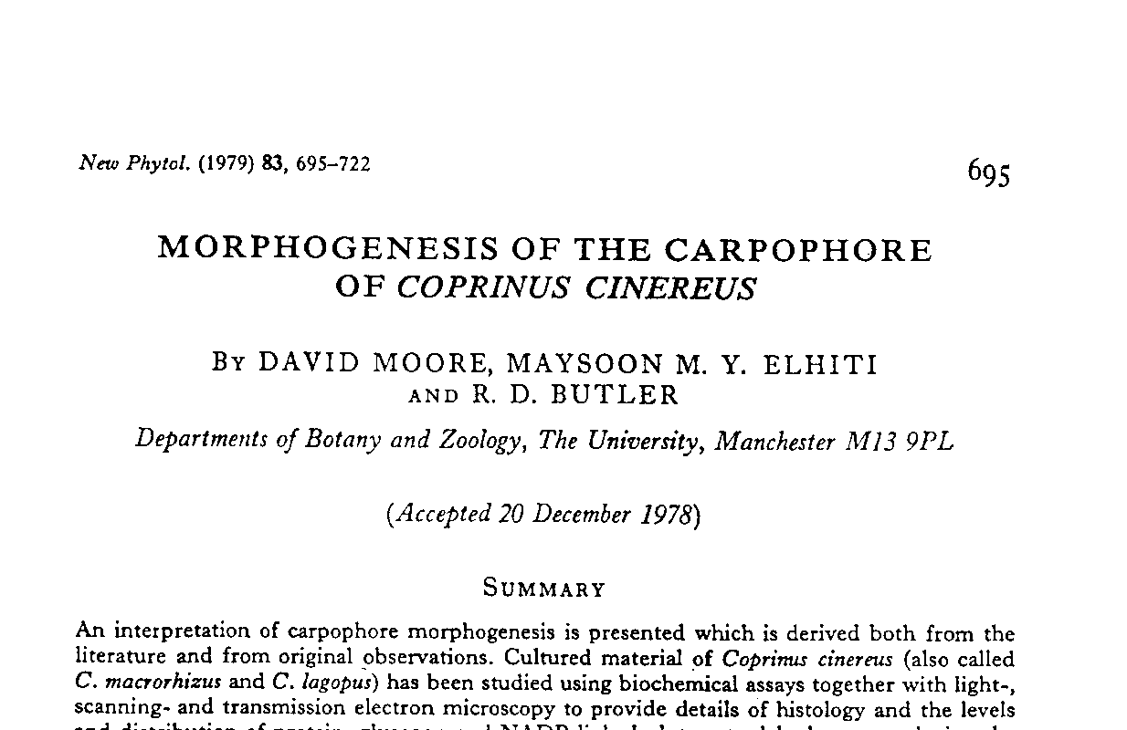

Slide 20
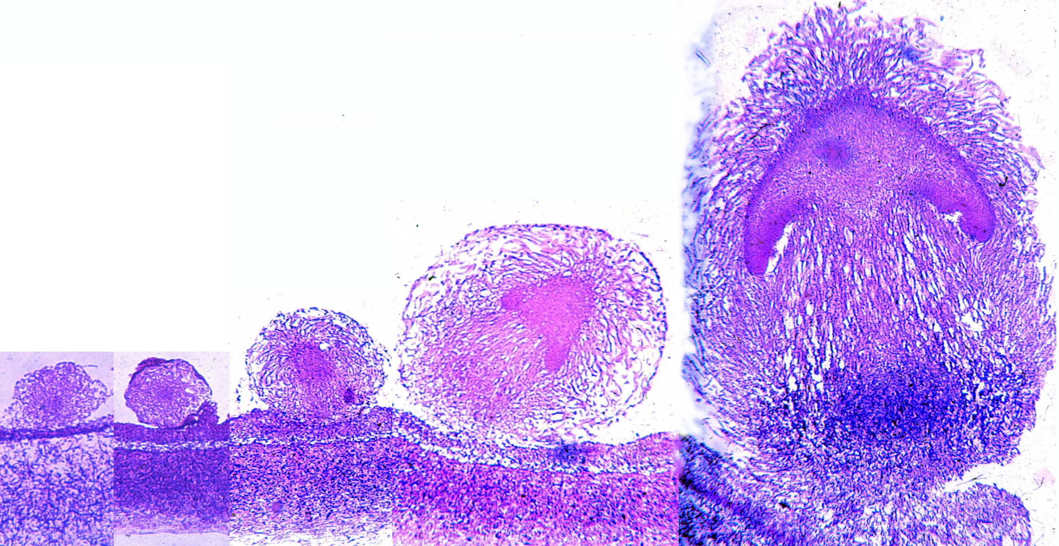
1 mm

Slide 21
The keys to form and structure in fungi
Novel experimental approaches to study of development recently introduced:
gravitropism as a morphogenetic model
quantitative analysis of cell sizes and distributions
in vitro tissue transplantations

Slide 22
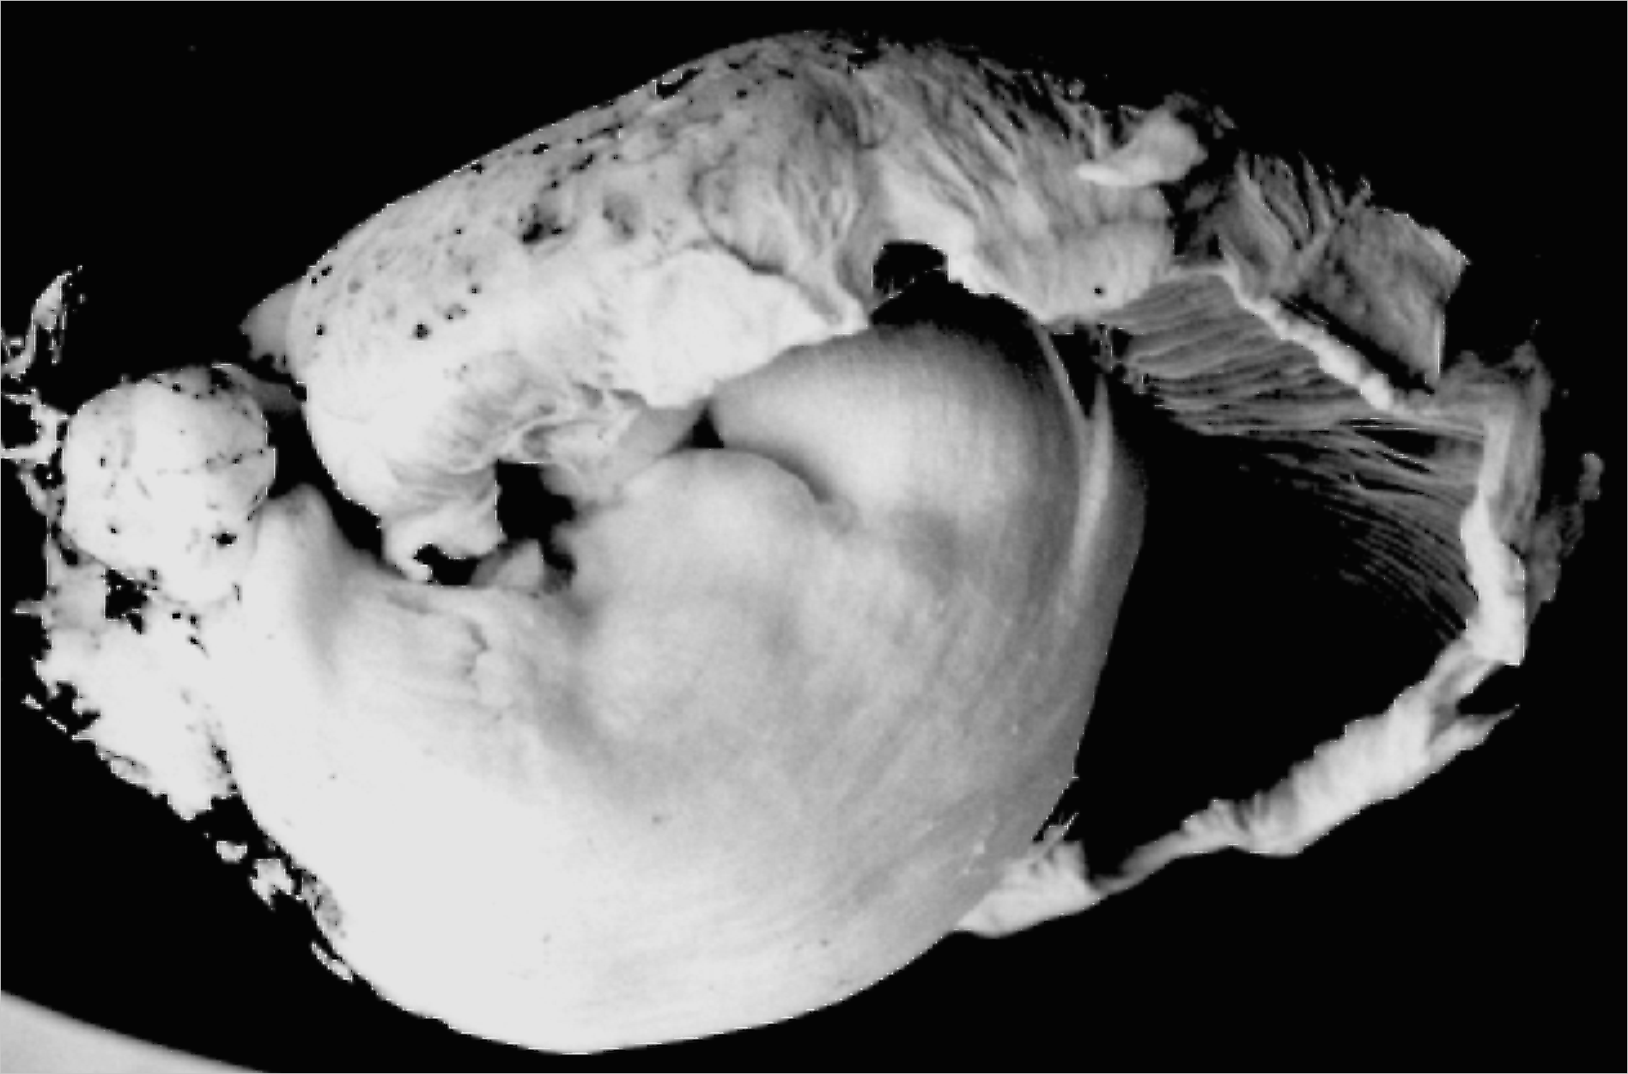
Agaricus bisporus gravitropism
Photo courtesy Halit Umar, Mushroom Experiment Station, Horst, The Netherlands

Slide 23
The gravitropic reaction is an imperative
vertical orientation of the fruit body is essential for effective spore release
it may be achieved even at the expense of other aspects of fruit body morphogenesis

Slide 24
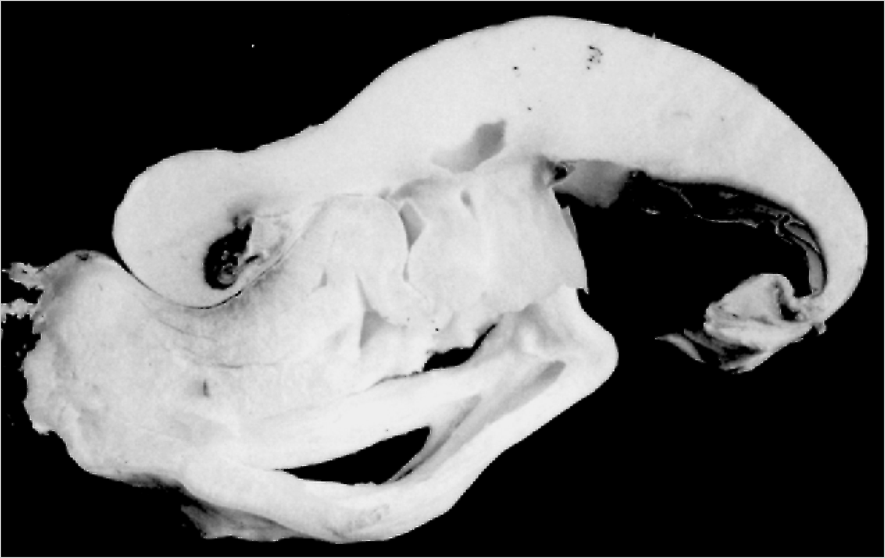
Agaricus bisporus gravitropism
Photo courtesy Halit Umar, Mushroom Experiment Station, Horst, The Netherlands

Slide 25
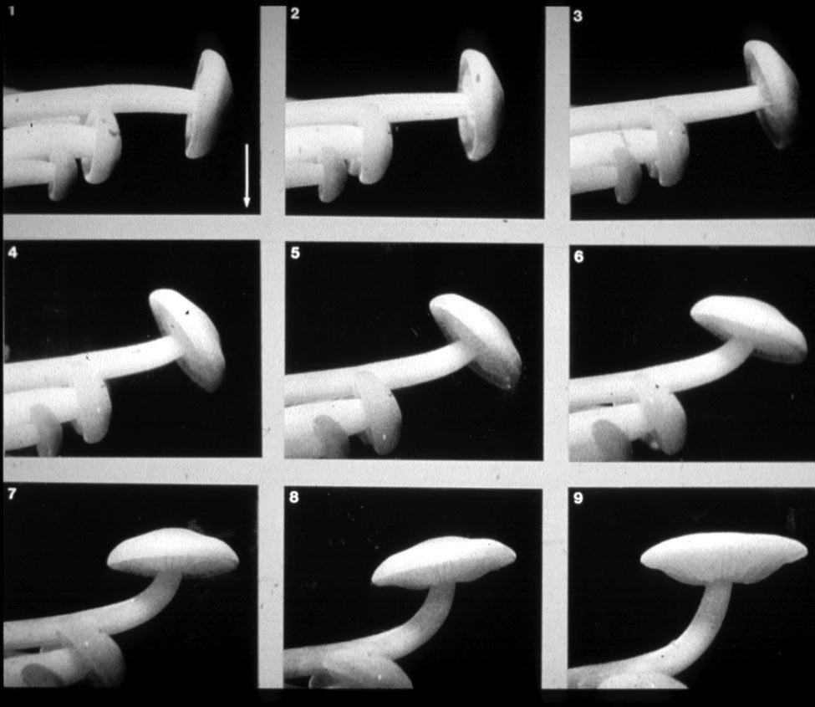
Flammulina velutipes gravitropism

Slide 26
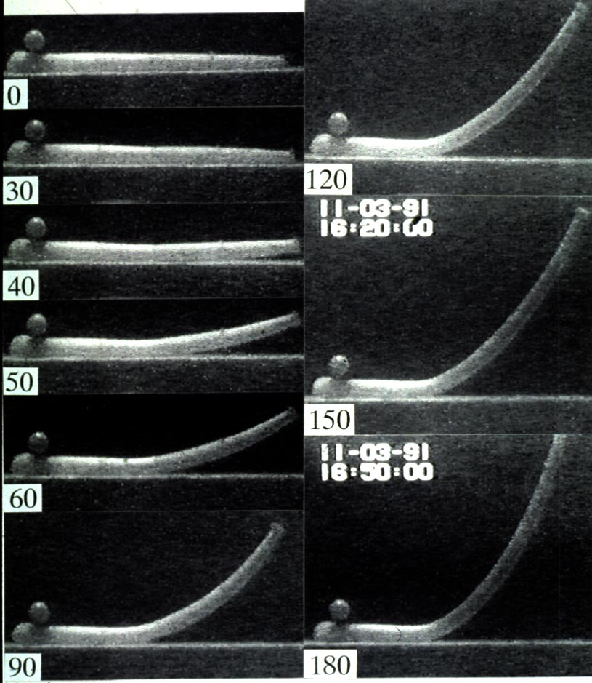
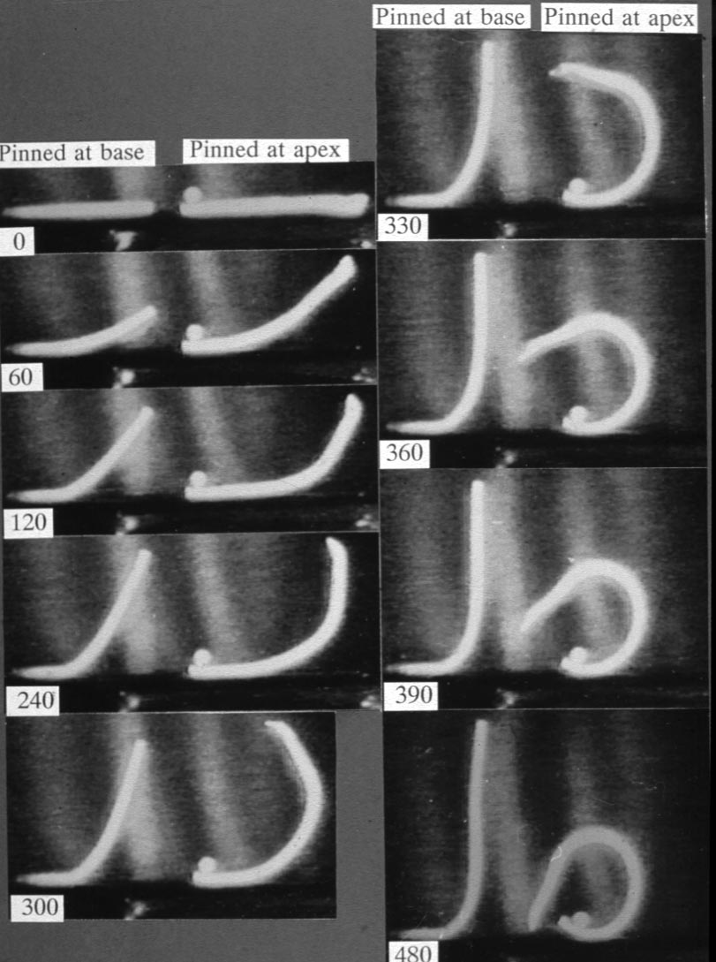
Coprinus cinereus gravitropism

Slide 27
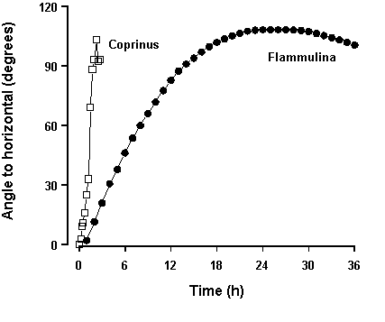
Comparing Coprinus and Flammulina

Slide 28
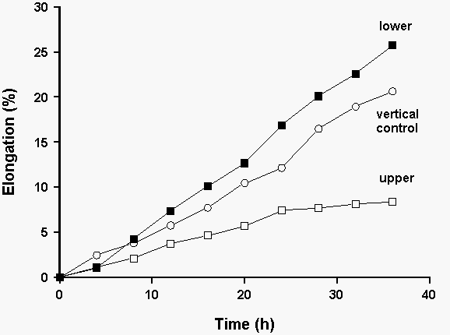
Flammulina velutipes gravitropism

Slide 29
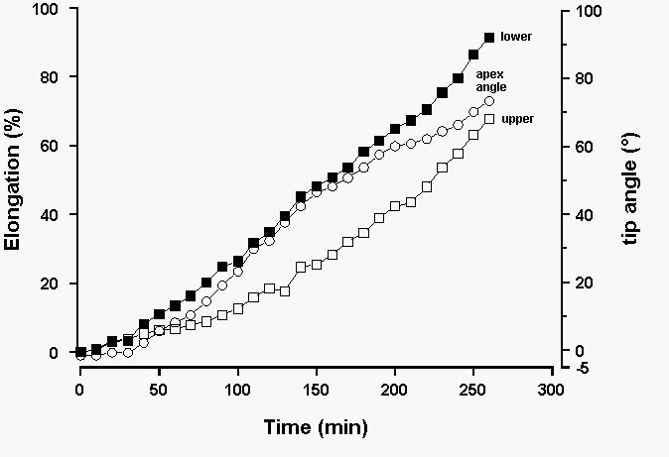
Coprinus cinereus gravitropism

Slide 30
Cell sizes in bending stems of Coprinus cinereus
Lower region Upper region
Mean width of 20.9 ± 3.6 19.9 ± 3.0
hyphae (µm)
% narrow hyphae 30.5-39.1 28.8-41.5
Packing density 0.44 0.47
Cell length (µm) 542 116

Slide 32
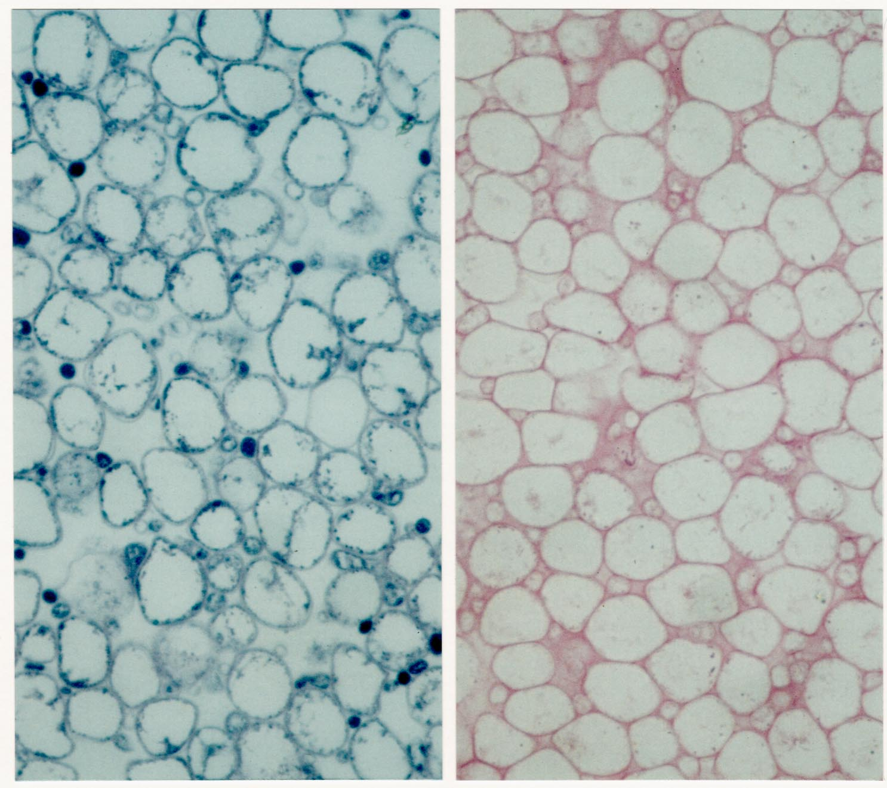

Slide 34
Cell size dynamics in the stem
a specific inner zone of cells inflates
this deep-seated inflation pulls the stem axis apart to create the lumen AND stretches outer tissues
result is a hollow cylinder with an outer ‘skin’ stretched over inner compressed tissue
in engineering terms, an ideal structure for a columnar support

Slide 36
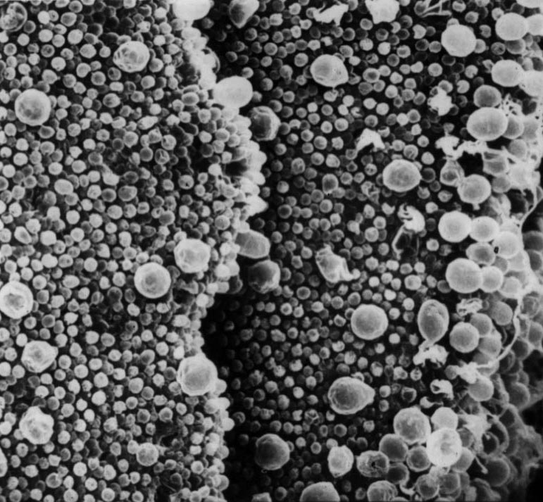
In vitro tissue transplantations

Slide 37
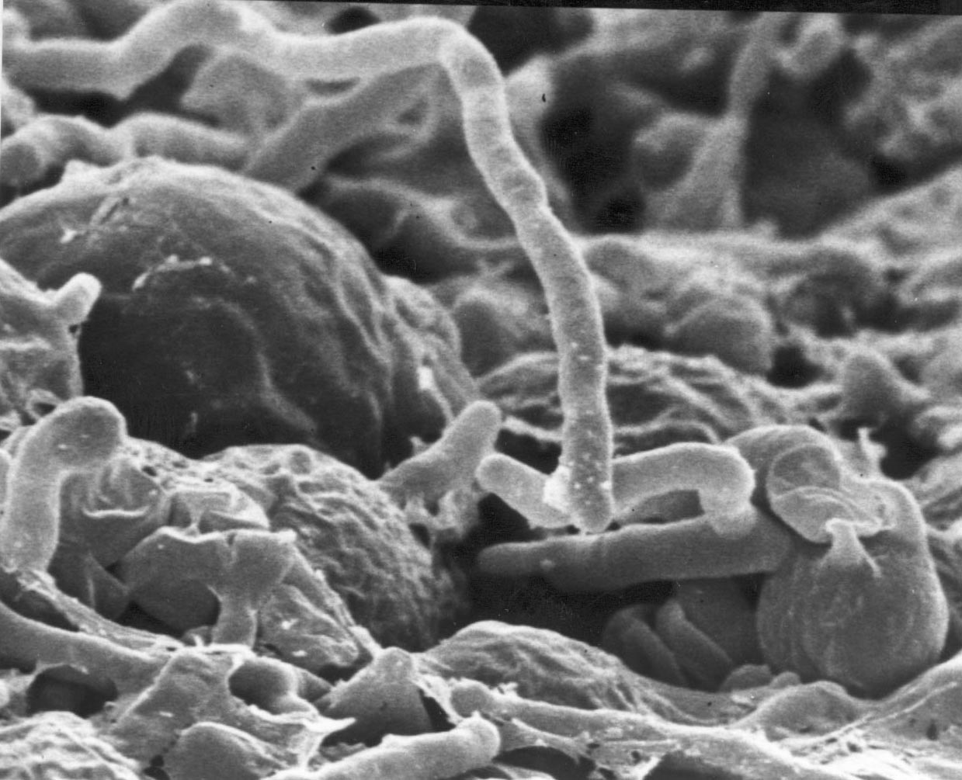
In vitro tissue transplantations

Slide 38
In vitro tissue transplantations
removal from its normal location results in most cell types of the gill reverting to vegetative hyphal growth
basidia are an exception

Slide 39
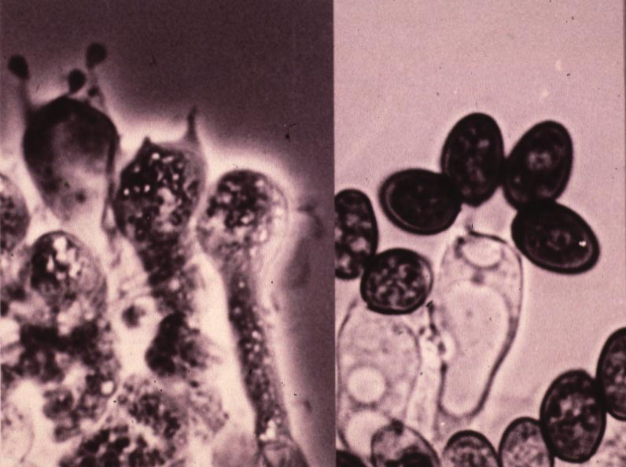
In vitro tissue transplantations

Slide 40
In vitro tissue transplantations
if transplanted after the start of meiosis, then meiosis and sporulation continue
so basidia are committed to their developmental pathway
unless ammonium ions are present ...

Slide 41
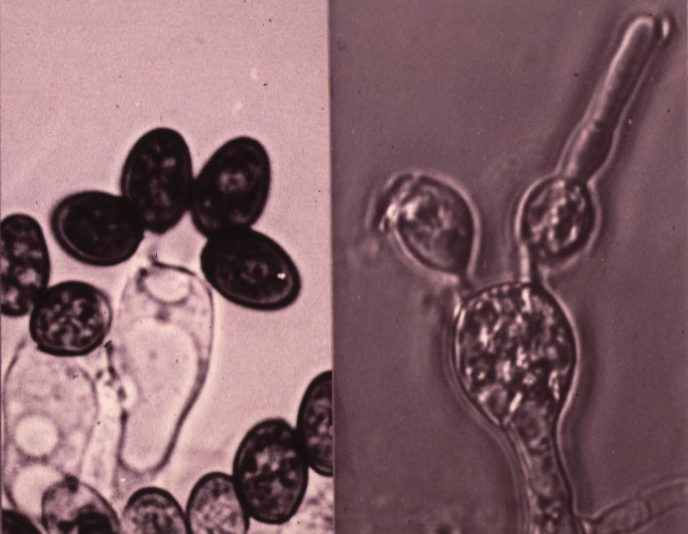
In vitro tissue transplantations

Slide 42
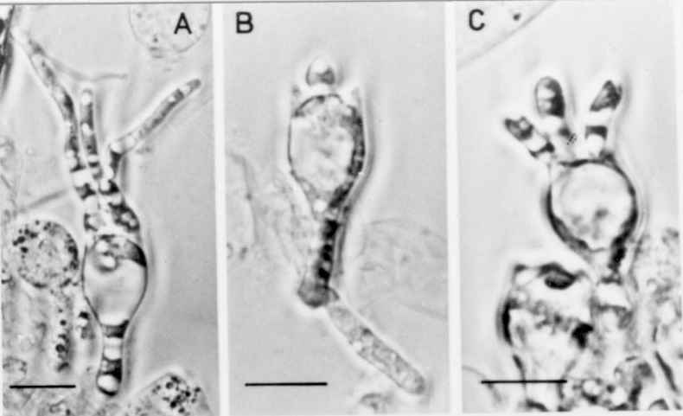
Ammonium ions break basidial commitment to sporulation

Slide 43
Remember glutamate dehydrogenase?
derepressed specifically in the cap
one of a complex of ammonium assimilating enzymes which derepress together
but at a time when ammonium assimilation is unnecessary

Slide 44
Remember glutamate dehydrogenase?
its true function?
ammonium DETOXIFICATION
sitting on top of a dung heap with an ammonium-inhibited sporulation process, the fruit body needs a DETOXIFIER!

Slide 45
The keys to form and structure in fungi
gene expression relies on previously-formed cell and tissue structures
the total environment is the ‘network’ or ‘context’ within which new gene products must work
this ‘network’ or ‘context’ includes chemical, electrical and structural or mechanical tensions as well as cell and organelle structures

Slide 46
Control of fungal morphogenesis
Homologues and analogues of all of the developmental mechanisms known in animals and plants can be found in fungi
mechanical effects
temporal sequencing
pattern formation and morphogenetic fields
programmed cell death
reaction with extracellular matrix

Slide 47
Mechanical effects
stem structure is one example already discussed
gill morphology is another ...

Slide 48
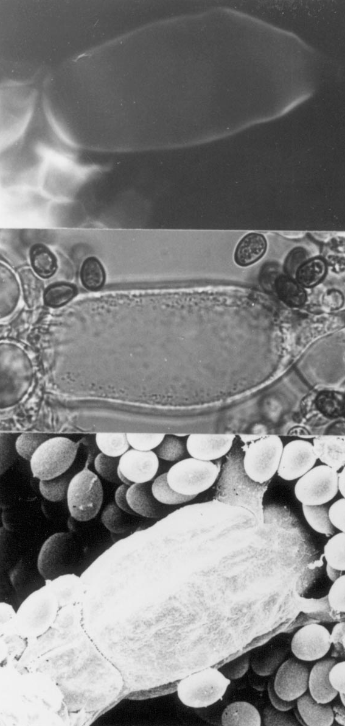
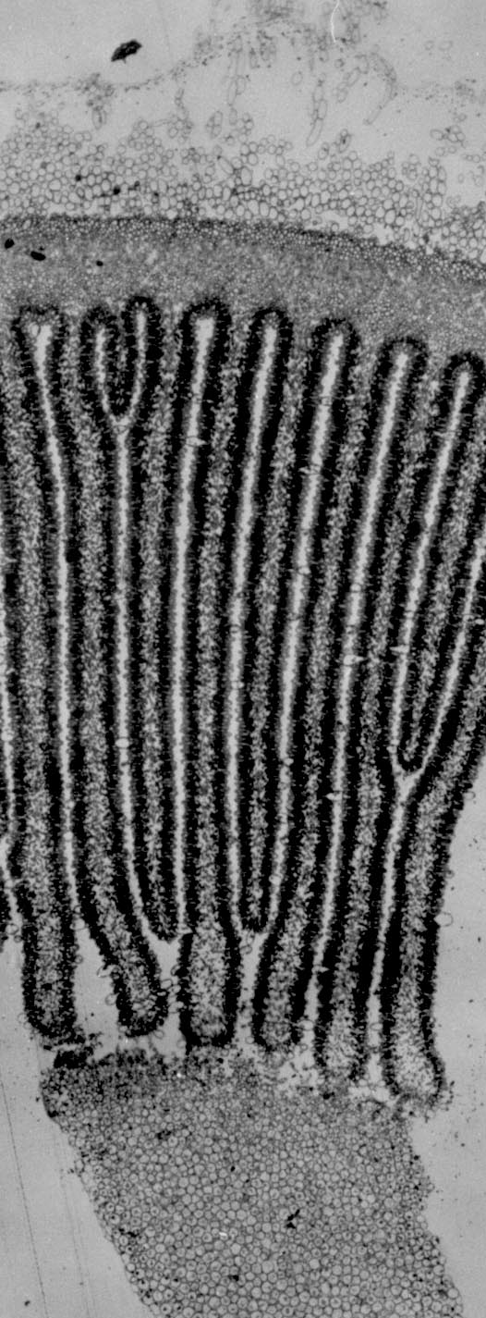
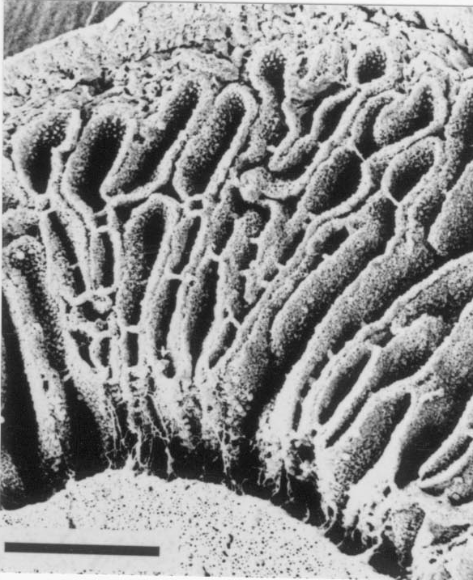
Embryonic gills are contorted

Slide 49
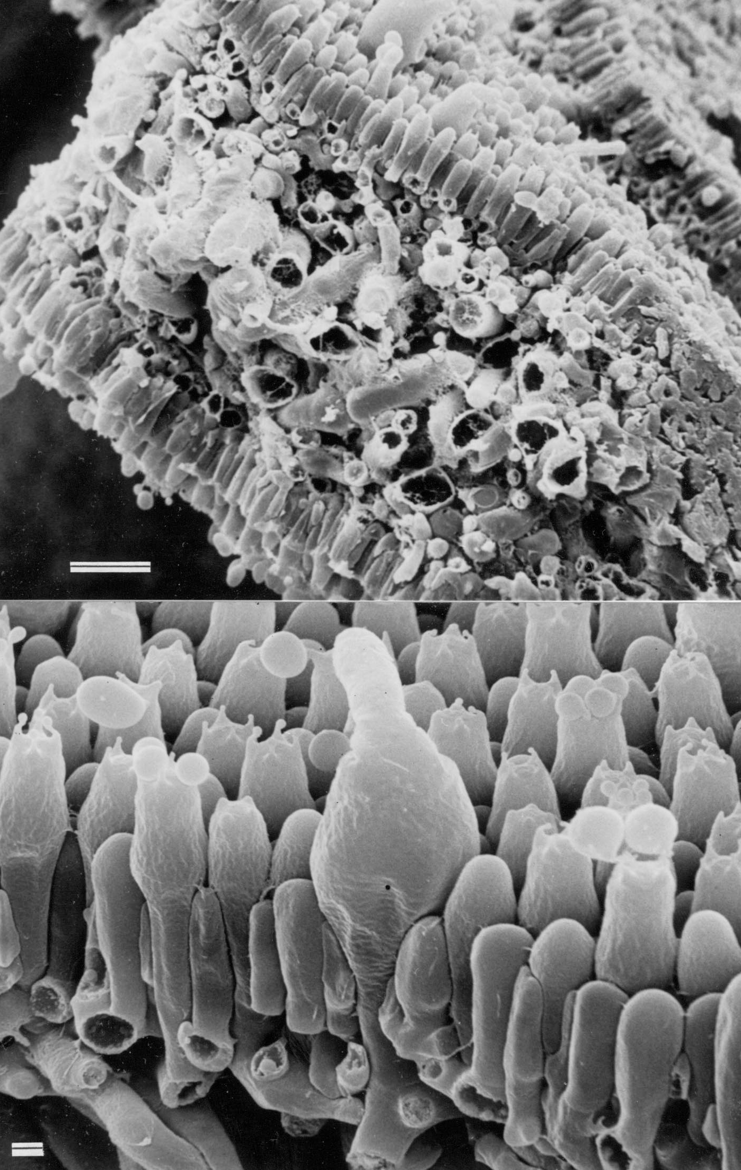
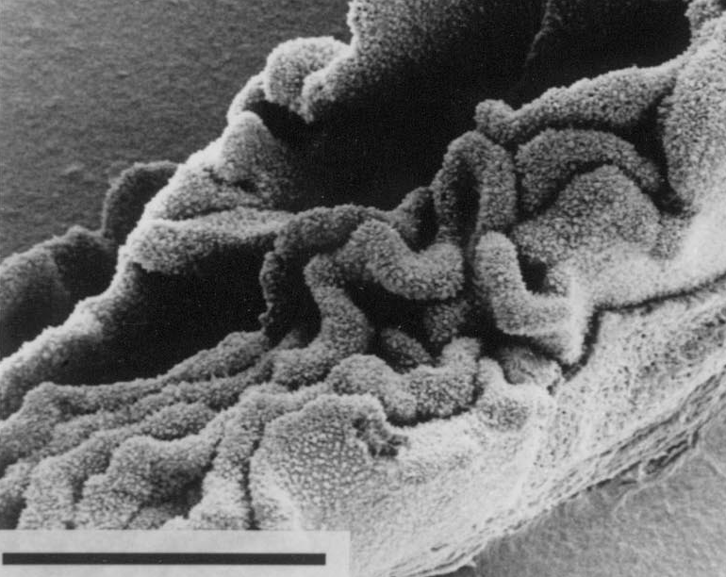
Embryonic gills are contorted

Slide 50
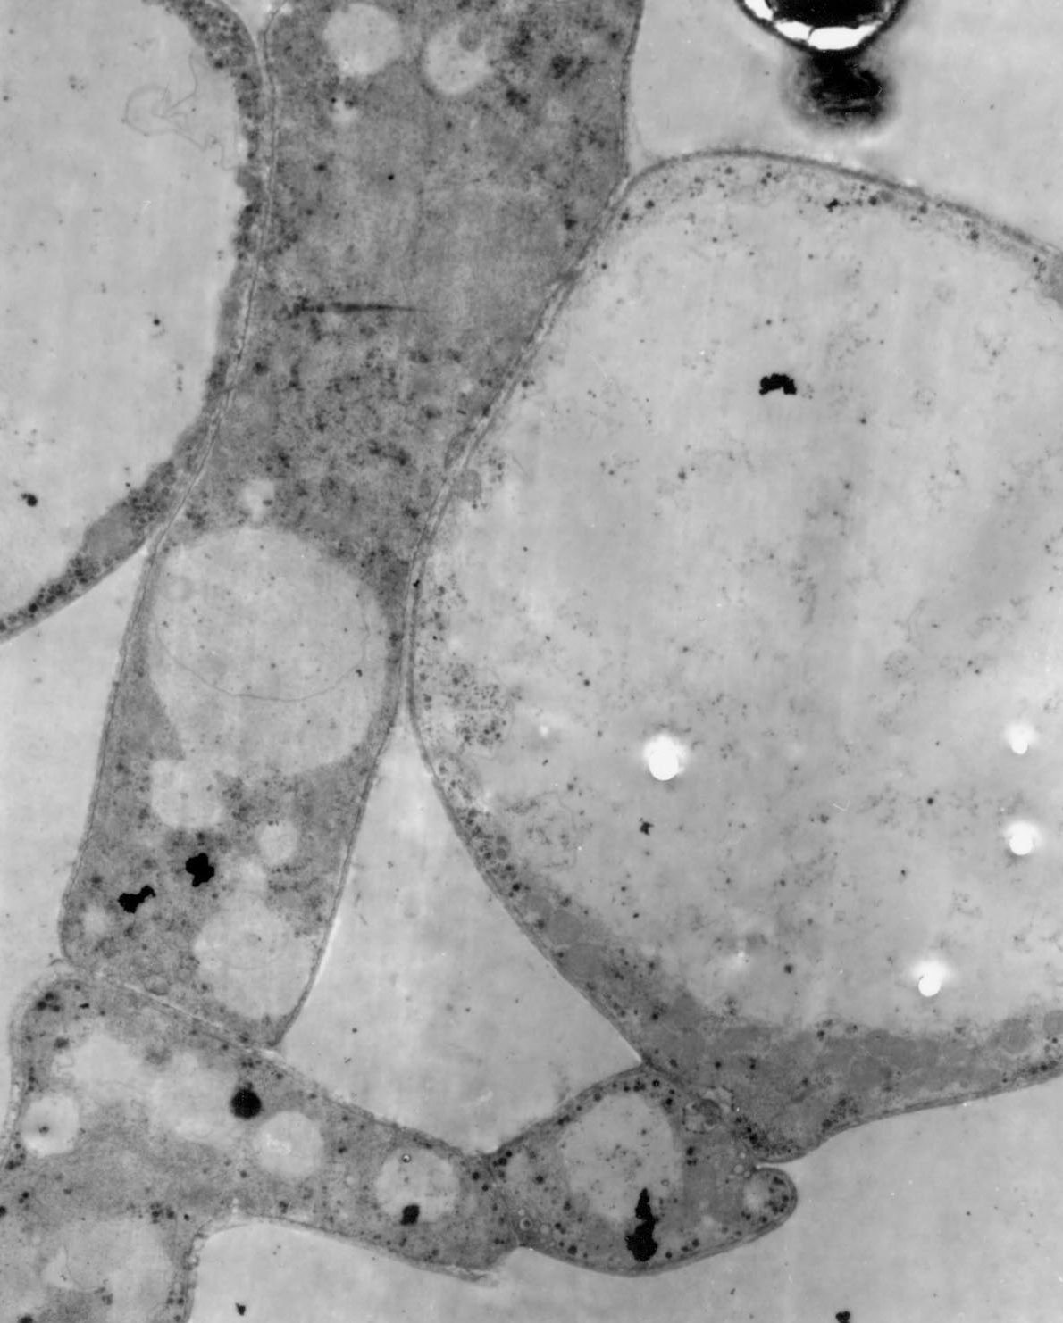
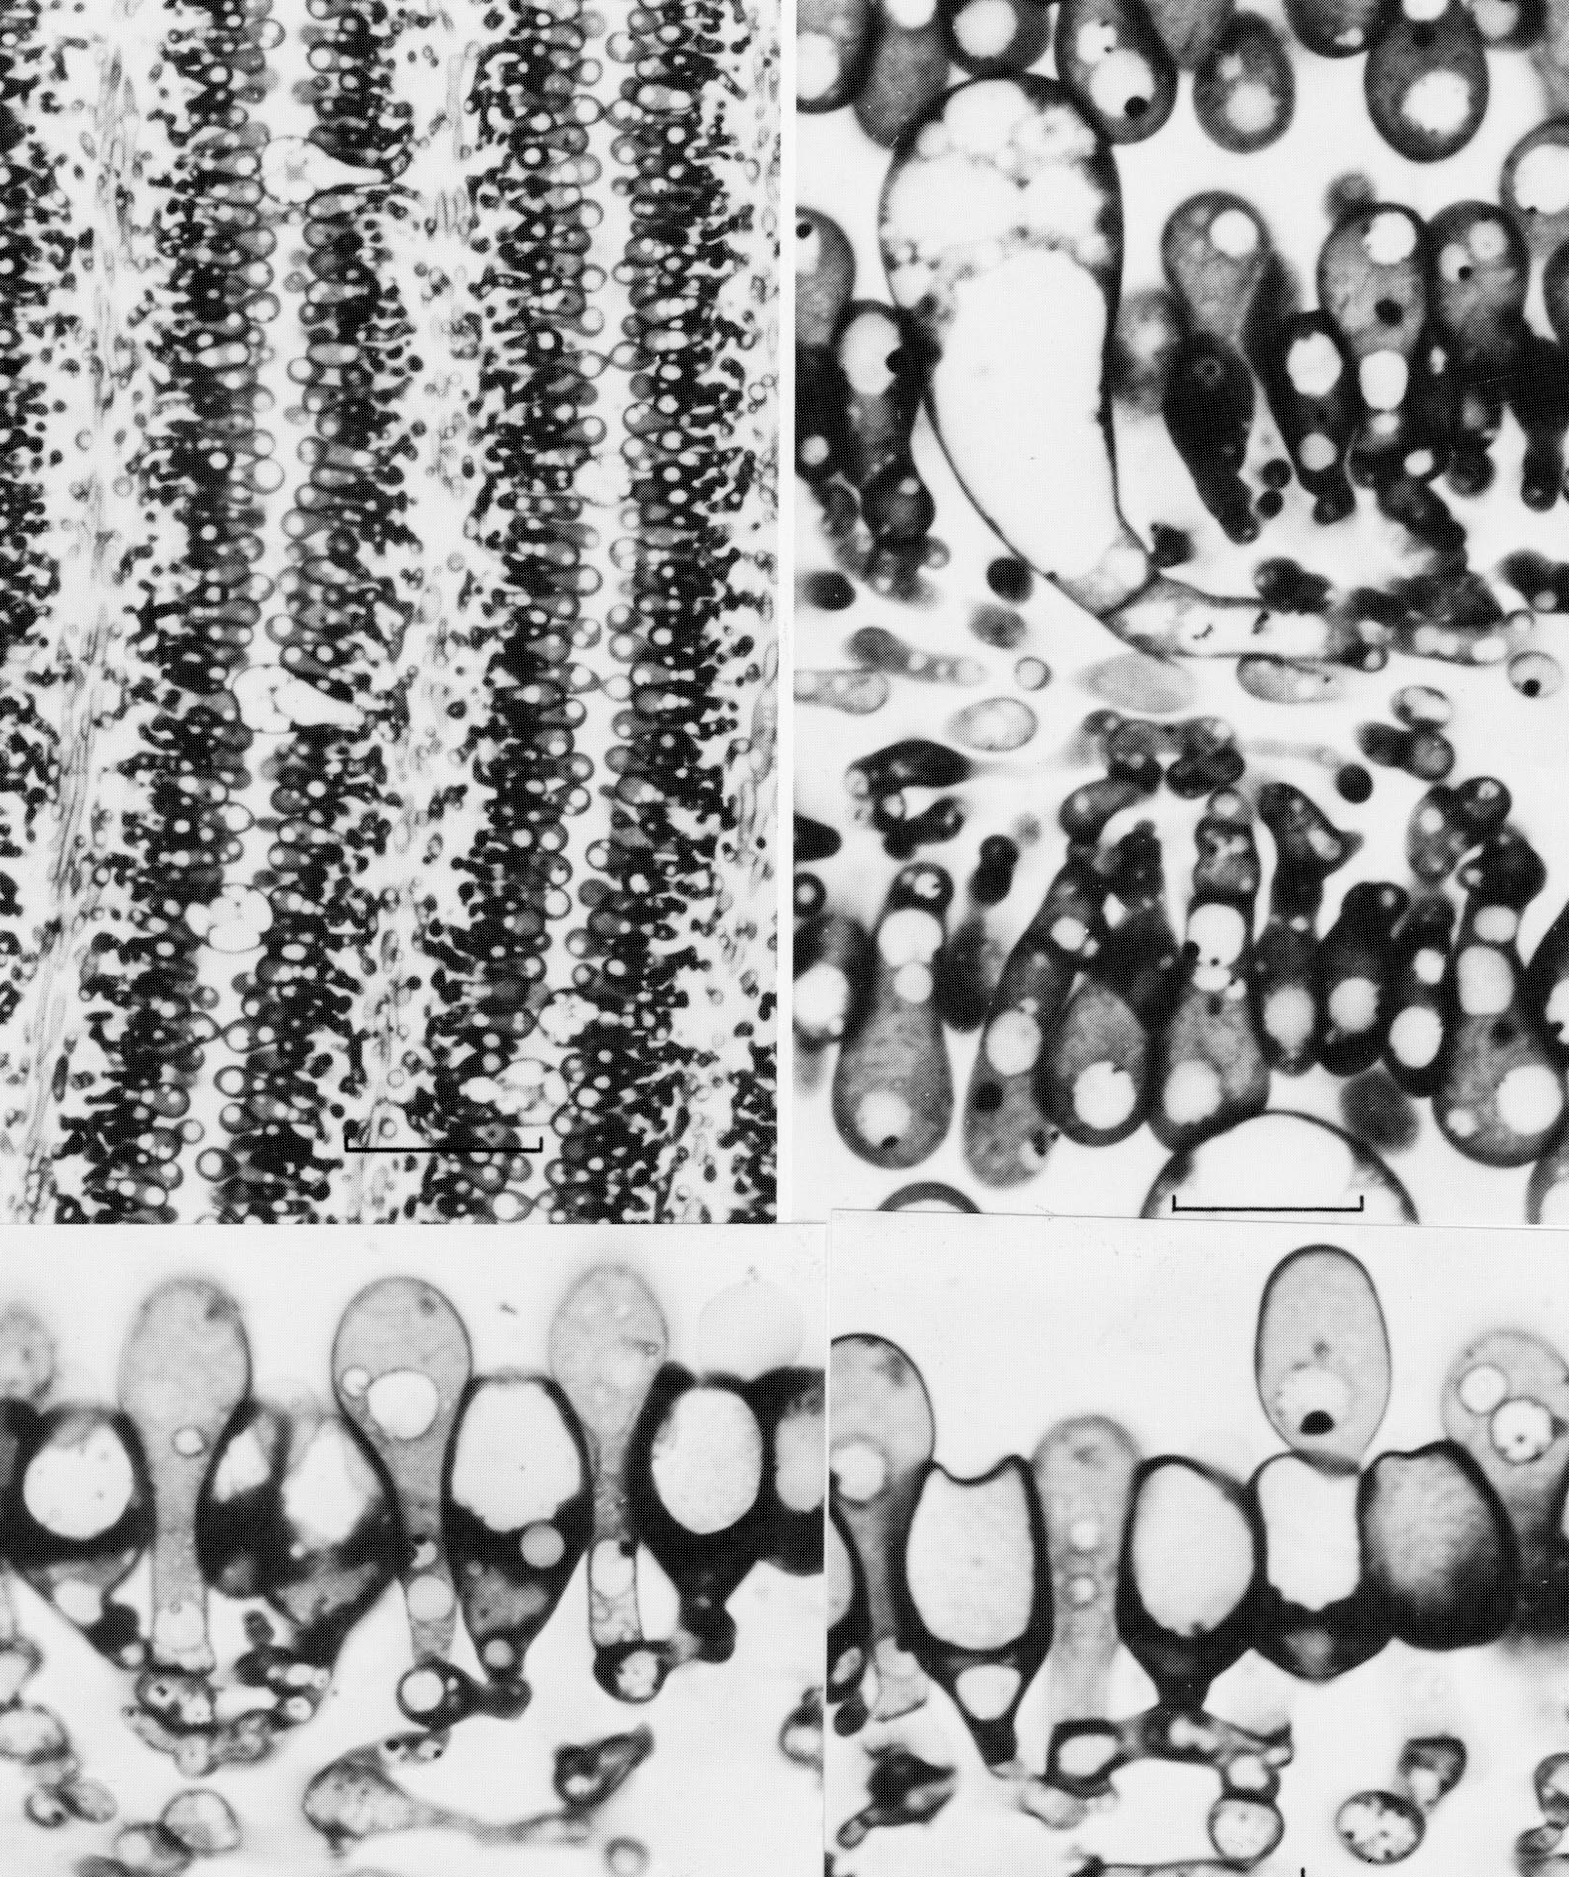
Temporal sequencing: hymenium assembly in Coprinus
paraphyses arise as sub-basidial branches

Slide 51
Pattern formation and morphogenetic fields
a cystidium controls a local morphogenetic field

Slide 52
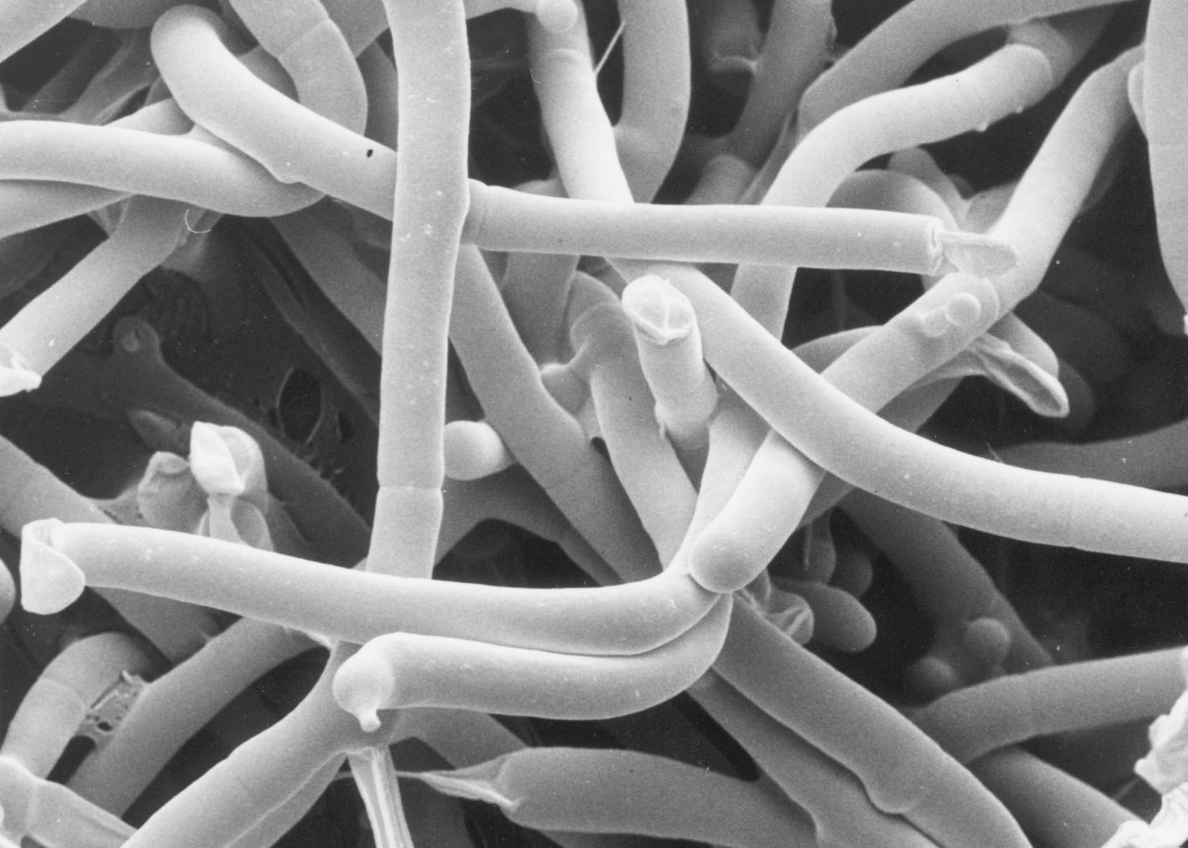
Programmed cell death
hyphal compartments are sacrificed to trim hyphae to shape
Scanning electron micrograph of a fruit body initial of Pleurotus pulmonarius, courtesy of Carmen Sanchez

Slide 53
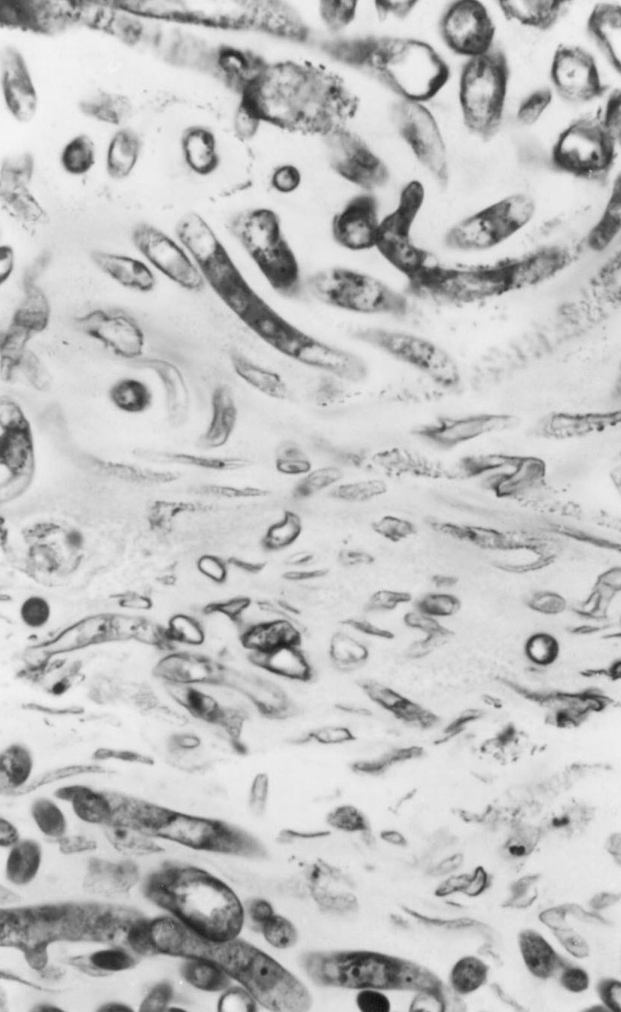
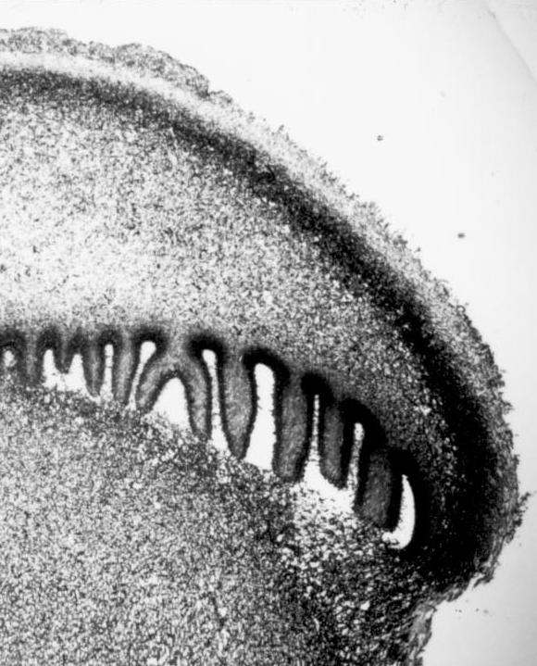
Programmed cell death
tissues are sculptured by extensive sacrifice of hyphae
Light micrographs of a fruit body of Psilocybe cubensis, courtesy of Halit Umar

Slide 54
Extracellular matrix
In this last example the program leading to cell death involves the sacrificed cells over-producing extracellular matrix and then lysing to release it
this emphasizes the importance of the extracellular matrix in fungal development

Slide 55
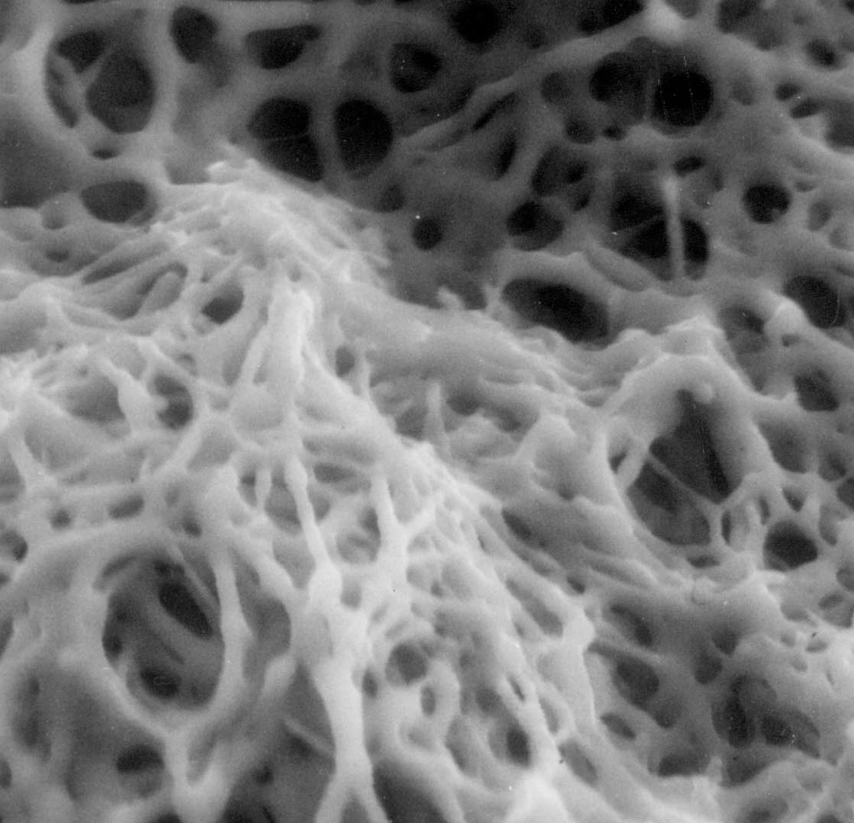
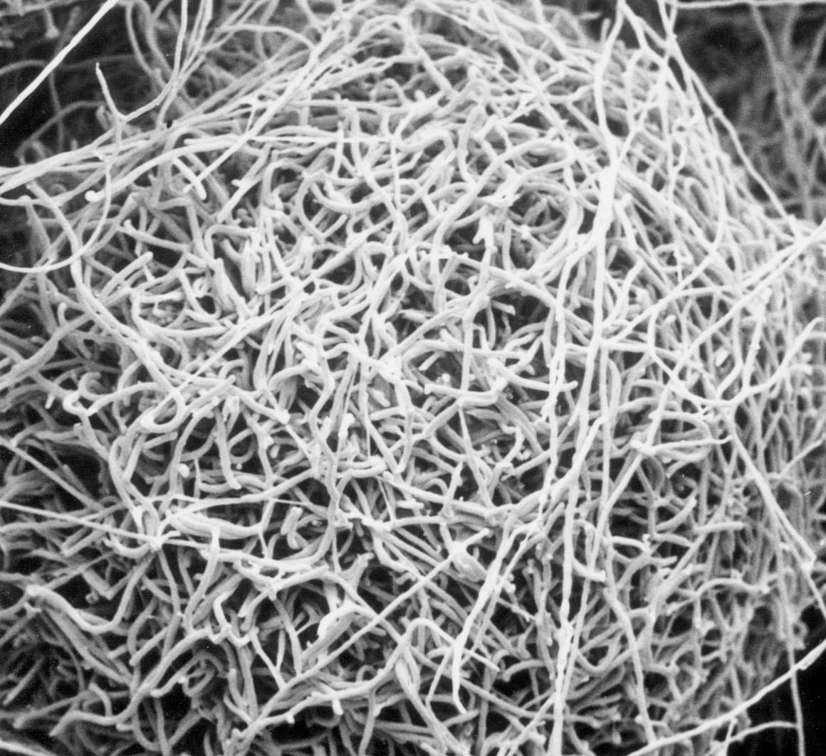
Extracellular matrix
the fungal extracellular matrix is extensive and complex
Scanning and environmental electron micrographs of a fruit body initial of Pleurotus pulmonarius, courtesy of Carmen Sanchez

Slide 56
Reinforcement of differentiation
Hyphal cells require reinforcement of their differentiation 'instructions'. This reinforcement is part of the context within which they normally develop and may involve:
production of location- and/or time-specific extracellular matrix molecules
smaller molecules serving as hormones or growth factors
uptake is not necessary

Slide 57
Reinforcement of differentiation
these molecules may react with integrins and the existing extracellular matrix
such direct effects on the cytoskeleton can cause immediate metabolic changes in one or more cellular compartments
or directly influence gene transcription
this is ‘outside-in’ signalling

Slide 58
Patterning genes?
Not necessarily …
a specific gill pattern in an agaric, say, may result because the application of general rules within the context of its development ‘invariably’ results in that pattern

Slide 59
Developmental subroutines
  Another common feature is that fungal morphogenesis is compartmentalized into a collection of distinct developmental processes (called 'subroutines'), recognizable at all levels:
organs (e.g. cap, stem, veil, etc.)
tissues (e.g. hymenophore, context, pileipellis, etc.)
cells (e.g. basidium, paraphysis, cystidium, etc.)
cellular components (e.g. wall growth may be uniform, in girth, in length or in thickness)

Slide 60
Developmental subroutines
developmental subroutines are distinct genetically and physiologically
may run in parallel or in sequence

Slide 61
Developmental subroutines
when played out in their correct arrangement, ‘normal’ morphology results
if some subroutines are disabled (genetically or through physiological stress), the rest may still proceed
such partial execution produces an abnormal morphology

Slide 62
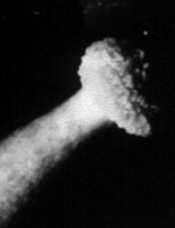
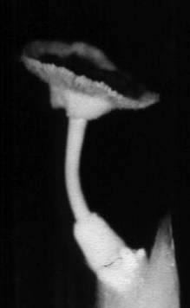
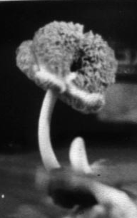
But spores are still produced...

Slide 63
Volvariella bombycina

Slide 64
Tolerance of imprecision
The flexibility in expression of developmental subroutines allows the fruit body to react to adverse conditions and still produce a crop of spores
it also illustrates that tolerance of imprecision is an important attribute of fungal morphogenesis
fungal development uses fuzzy logic rather than crisp logic

Slide 65
Control of fungal morphogenesis
Mating type factors provide prime examples of elements able to regulate specific morphogenetic subroutines in fungi. Mating factor regulation involves:
transcriptional activation
transcriptional inhibition
intrachromosomal recombination to interchange regulatory cassettes

Slide 66
Control of fungal morphogenesis
Hyphal systems characteristically need to develop a state of competence before they are able to undertake the next developmental change, and can be precipitated into embarking upon a particular morphogenesis by a variety of environmental signals

Slide 67
Control of fungal morphogenesis
Consequently, other molecular models which might be used more widely are:
translational triggering, and
feedback fixation

Slide 68
Translational triggering
This is a mechanism which can relate a morphogenetic pathway to the development of competence on the one hand, and to initiation in response to environmental cue(s) on the other hand
nutrient, especially nitrogen, limitation may be crucial in regulating morphogenesis

Slide 69
Translational triggering
The limitation may be imposed by a compartmentalization of:
amino acid (or a precursor)
specific tRNA
aminoacyl-tRNA synthetase
any or all compartmentalized, regulated in local concentration, or both

Slide 70
Translational triggering
competent state achieved and differentiation transcripts are produced
trigger-ORF translation allows downstream sequences to assume secondary structure that blocks their translation

Slide 71
Translational triggering
a specific check to growth causes ribosomes to stall at trigger-ORF
RNA assumes an alternative secondary structure which allows downstream translation

Slide 72
Translational triggering
The ‘check to growth’ might be caused by
illumination
temperature shock
nutritional crisis
injury
edge encounter
extracellular matrix signal
other factors

Slide 73
Feedback fixation
This is the outcome of feedback activation and autoregulation which together reinforce expression of the whole regulatory pathway to make it independent of the external environmental cues which initiated it.

Slide 74
Feedback fixation
where control of expression is ‘fuzzy’ being reinforced by external signals

Slide 75
Feedback fixation
where control of expression is ‘crisp’ and independent of external signals in committed cells

Slide 76
Feedback fixation
feedback fixation results in developmental determination in the classic embryological sense
the epigenetic aspects of the network governing fungal morphogenesis starts with feedback fixation, but can also include signals from outside the cell

Slide 77
Control of fungal morphogenesis
The focus of these hypothetical regulatory activities is, obviously, the hyphal wall, its surface and the immediate extracellular environment
the key to fungal morphogenesis lies in understanding how that which is outside a hypha can influence that which goes on inside the hypha in a time- and place-dependent manner

